Slide 1
Examples of Project burndown charts

Slide 2
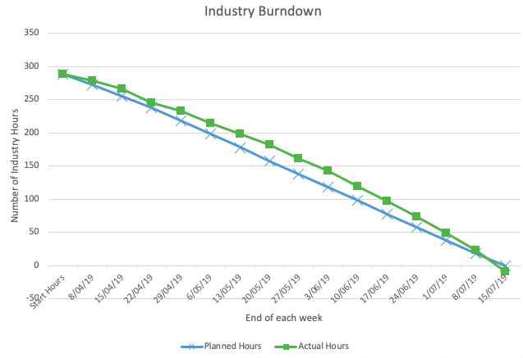
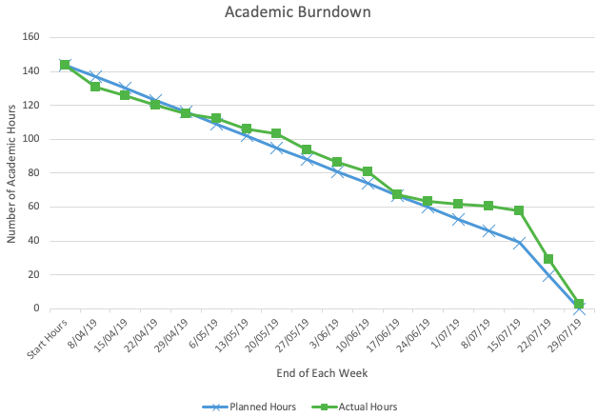
Time Management

Slide 3
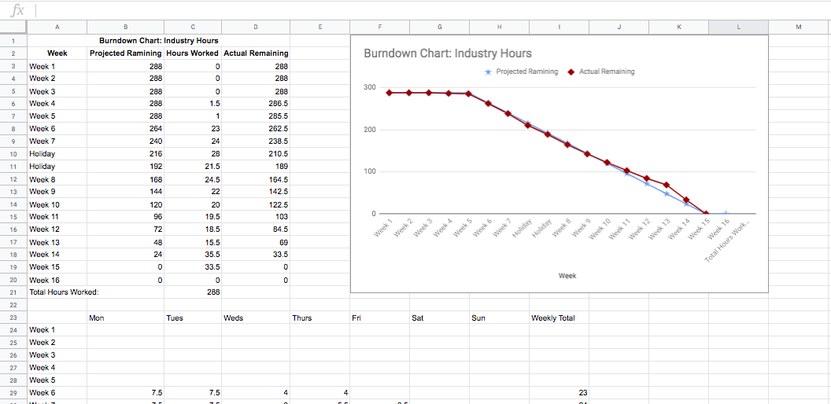
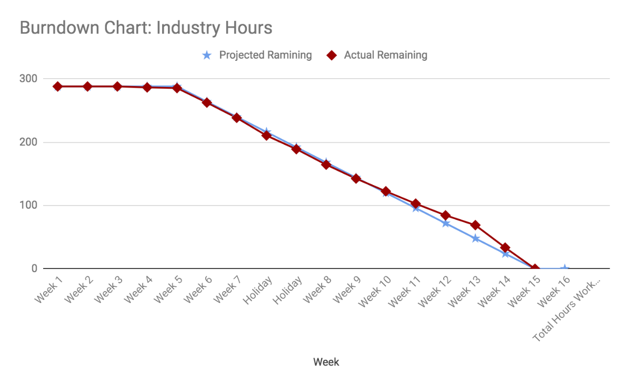
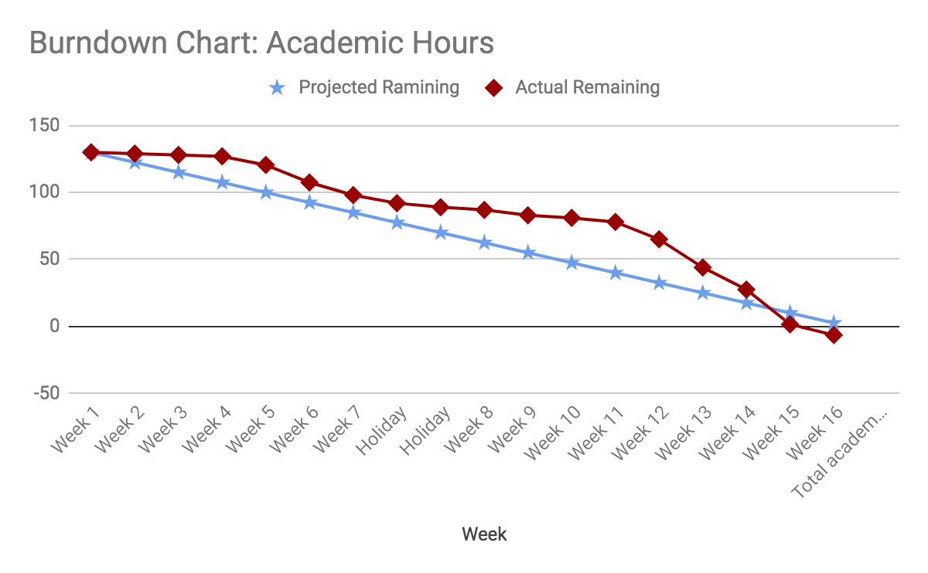
Project management
Hours tracked using Google Sheets and Toggl
Notes:
Now project management was vital to ensuring the success of this project. For I start, I was required to meet 288 industry hours and 130 academic hours.
I also needed to stay aware of my time, to make sure that I had enough time to achieve my goals.
I used a combination of burndown charts and Toggl to track my hours and you can see my final burndown charts on the wall.
I found my burndown charts to be invaluable, as they helped me to ensure I was staying on top of my work.
This was especially important when I got sick, midway through my project and had to take time off from work and it meant I knew exactly how much leeway I had.

Slide 4
Project Management
13 weeks – 292 hours
Using MeisterTask to manage my tasks
Weekly Meetings with Industry Supervisor – not regular
Informal meetings with teammate
Notes:
Industry hours = struggle to keep up with the estimated hours but by the end, managed to fill the min hours
Meetings with industry supervisor = every wed or Fridays
weren’t often as only meet up to gather requirements or demonstrate dashboard
Only the first half of the project it was regular
No structure to my meetings with teammate = discuss ideas, tasks done
NEXT = show management tool

Slide 5
Course Management
17 weeks – 165 hours
Academic Supervisor
Send weekly reports
Meetings every Monday
Management Tool
Excel Spreadsheet
Burndown Chart
Notes:
Meetings with Luofeng on mondays
Deliverables: proposal, halfway, final, method essay, poster
NEXT = weekly report

Slide 6
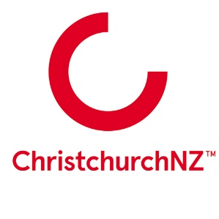
Project Management - Industry
12 weeks | 292 hours total
CrispDM methodology used to design data dashboards
Scrumban board used to manage tasks.
Requirements meetings with clients

Slide 7
Project Management - Academic
Weekly reports sent to Rob & Amit
Weekly meetings with Rob & Amit on Tuesdays at 11am
Project proposal, halfway and final reports

Slide 9
Industry Burndown

